Slide 1

DGS General Coding Guideline

Slide 2
Agenda
DGS C-Standard data types and Base types in MEDC17, MDG1 and AUTOSAR
C−standard data types used in the *.c and *.h files
MEDC17/MDG1 Obsolete data types in C−code
BASE TYPES used for the data specification in PaVaSt files
MEDC17/MDG1 Obsolete data types in PaVaSt
MEDC17/MDG1 Standard data types for special purposes
MEDC17/MDG1 Float data types
Size and signedness of an arithmetic type
User defined data types – typedefes
DGS Standard symbols
2
RBVH/EJV31 | 2018-06-27
© Robert Bosch Engineering and Business Solutions Vietnam Company Limited 2018. All rights reserved, also regarding any disposal, exploitation, reproduction, editing, distribution, as well as in the event of applications for industrial property rights.

Slide 3
What is the size of integer?
QUESTION
1 byte
2 bytes
3 bytes
4 bytes
5 bytes
6 bytes
7 bytes
8 bytes
3
RBVH/EJV31 | 2018-06-27
© Robert Bosch Engineering and Business Solutions Vietnam Company Limited 2018. All rights reserved, also regarding any disposal, exploitation, reproduction, editing, distribution, as well as in the event of applications for industrial property rights.

Slide 4
C-standard data types

Slide 5
C−standard data types used in the *.c and *.h files
DGS C-Standard data types and Base types
Only the standard types provided by the common header include chain shall be used MEDC17 and MDG1
bit......................... bit type only for ASCET and MEDC17 SW−Build header generation
bool.......................boolean type only for DGS ASW manual coding and ASCET
boolean................ boolean type only for BSW and ML/SL
uint8, sint8 ........... unsigned/signed 8−Bit integer types for all
uint16, sint16 ....... unsigned/signed 16−Bit integer types for all
uint32, sint32........ unsigned/signed 32−Bit integer types for all
real32 .................. single precision (32−Bit) float types only for DGS ASW manual coding and ASCET
float32 ................. single precision (32−Bit) float types only for BSW and ML/SL
5
RBVH/EJV31 | 2018-06-27
© Robert Bosch Engineering and Business Solutions Vietnam Company Limited 2018. All rights reserved, also regarding any disposal, exploitation, reproduction, editing, distribution, as well as in the event of applications for industrial property rights.

Slide 6
C−standard data types used in the *.c and *.h files
DGS C-Standard data types and Base types
The AUTOSAR data types boolean and float32 are provided by the BSW for MDG1.
Complex driver may use the data types boolean and float32 on C−code level if necessary. Some constraints need to be considered for the AUTOSAR data types "boolean" and "float32"
Example:
1. prototypes for call back functions are generated in BSW with the return type "boolean". But they may be defined in DGS with the return type "bool".
2. DGS header files which are included in EcM_Cfg_Startup.c need to include std_type.h to get the legacy datatypes like bool,....).
float64 is currently not available in the AUTOSAR specifications.
"bit" may cause misunderstandings: The data type "bit" should not be used to define a boolean variable locally in C−code.
Example:
bit MyComp_flgElemFound; /* NOK, bit is misleading */
bool MyComp_flgElemFound; /* OK, if the variable is a local flag */
6
RBVH/EJV31 | 2018-06-27
© Robert Bosch Engineering and Business Solutions Vietnam Company Limited 2018. All rights reserved, also regarding any disposal, exploitation, reproduction, editing, distribution, as well as in the event of applications for industrial property rights.

Slide 7
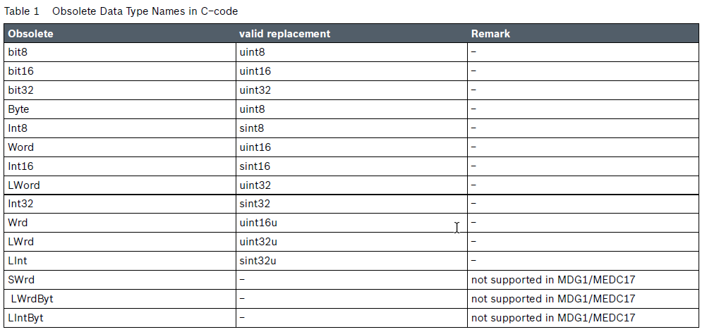
MEDC17/MDG1 Obsolete data types in C−code
DGS C-Standard data types and Base types
7
RBVH/EJV31 | 2018-06-27
© Robert Bosch Engineering and Business Solutions Vietnam Company Limited 2018. All rights reserved, also regarding any disposal, exploitation, reproduction, editing, distribution, as well as in the event of applications for industrial property rights.

Slide 8
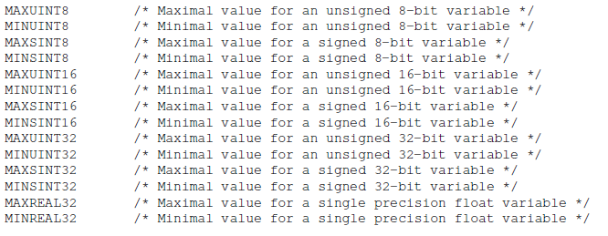
Limits of Data Types
DATA TYPES
8
DGS-EC/ESB4 - Stark | 2018-06-27
© Robert Bosch Engineering and Business Solutions Vietnam Company Limited 2018. All rights reserved, also regarding any disposal, exploitation, reproduction, editing, distribution, as well as in the event of applications for industrial property rights.

Slide 9
Base types to be used in pavast

Slide 10
BASE TYPES used for the data specification in PaVaSt files
DGS C−standard data types and Base types in MEDC17, MDG1 and AUTOSAR
bit......................... bit type or simple model
bool ..................... boolean type only for DGS ASW manual coding and ASCET.
boolean................ boolean type only for BSW and ML/SL.
uint8, sint8 .......... unsigned/signed 8−Bit integer types for all.
uint16, sint16 ........ unsigned/signed 16−Bit integer types for all.
uint32, sint32 ........ unsigned/signed 32−Bit integer types for all.
real32 ................... single precision (32−Bit) float types only for DGS ASW manual coding and ASCET.
float32 .................. single precision (32−Bit) float types for BSW and ML/SL.
10
RBVH/EJV3 | 2018-06-27
© Robert Bosch Engineering and Business Solutions Vietnam Company Limited 2018. All rights reserved, also regarding any disposal, exploitation, reproduction, editing, distribution, as well as in the event of applications for industrial property rights.
Notes:
Việc sử dụng data type thì hoàn toàn giống với C standard . Riêng đối với data types kiểu bit và simple model thì đc sử dụng theo qui ước

Slide 11
Bit type or simple model Convention
BASE TYPES used for the data specification in PaVaSt files
1. Only the standard types which are provided in the common header include chain and the base types which are supported by the tool chain shall be used everywhere in the MEDC17 and MDG1 software.
2. The base types bool, boolean and bit shall be considered of BIT category. No other base types shall be specified.
3. Only Manual Code and ASCET (not Mathlab/Simulink): Variables and messages of BIT category should be specified in PaVaSt by using DAMOS−models (TYP_MsgBitNoReIni, TYP_SingleBit*).
4. The CATEGORY VALUE shall not be used together with bit, bool and boolean type.
5. In C−Code the variables and messages of BIT category and bit type shall be accessed only via the tool chain generated macros GET_, SET_, PUT_, CLR_ .
11
RBVH/EJV3 | 2018-06-27
© Robert Bosch Engineering and Business Solutions Vietnam Company Limited 2018. All rights reserved, also regarding any disposal, exploitation, reproduction, editing, distribution, as well as in the event of applications for industrial property rights.
Notes:
4 điểm lưu ý
- những base type dạng bool và Boolean thì nên sử dụng dưới thể loại BIT, những cái khác thì ko sử dụng
-Đối với những cái manual code và ascet thì mình sử dụng reference mode
-Những cái biến ở thể loại Value thì sẽ sử dụng uint8/16/32, sint8/16/32, real32, float32
- Trong code C để mình sử dụng những cái sau quá trình DAMOS thì thông qua các macro

Slide 12
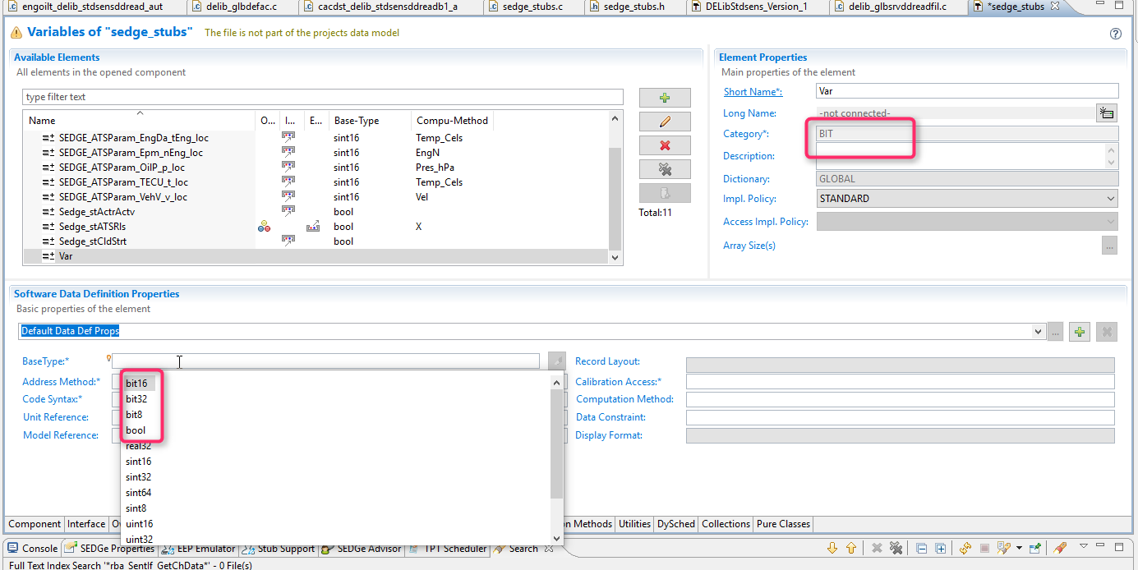
BASE TYPES shall be defined consistent to the PaVaSt Category
DGS C−standard data types and Base types in MEDC17, MDG1 and AUTOSAR
CATEGORY BIT.......................BASE TYPE: bit, bool, boolean. Others shall not be used
.
12
RBVH/EJV3 | 2018-06-27
© Robert Bosch Engineering and Business Solutions Vietnam Company Limited 2018. All rights reserved, also regarding any disposal, exploitation, reproduction, editing, distribution, as well as in the event of applications for industrial property rights.

Slide 13
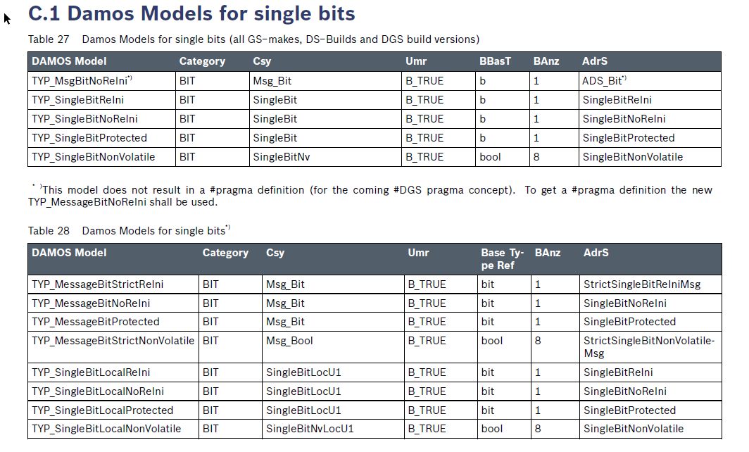
Bit type or simple model
DGS C−standard data types and Base types in MEDC17, MDG1 and AUTOSAR
13
RBVH/EJV3 | 2018-06-27
© Robert Bosch Engineering and Business Solutions Vietnam Company Limited 2018. All rights reserved, also regarding any disposal, exploitation, reproduction, editing, distribution, as well as in the event of applications for industrial property rights.

Slide 14
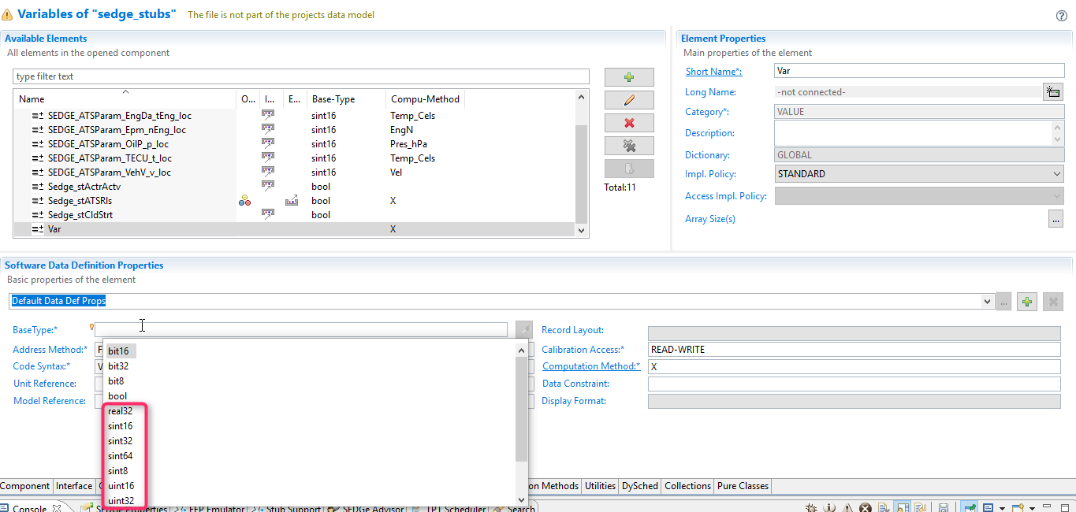
BASE TYPES shall be defined consistent to the PaVaSt Category
DGS C−standard data types and Base types in MEDC17, MDG1 and AUTOSAR
CATEGORY VALUE.................BASE TYPE: uint8/16/32, sint8/16/32, real32, float32.
14
RBVH/EJV3 | 2018-06-27
© Robert Bosch Engineering and Business Solutions Vietnam Company Limited 2018. All rights reserved, also regarding any disposal, exploitation, reproduction, editing, distribution, as well as in the event of applications for industrial property rights.

Slide 15
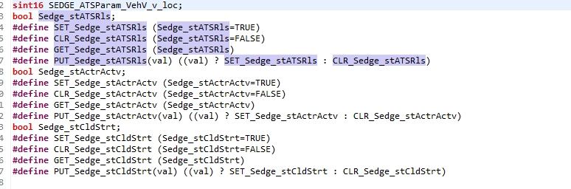
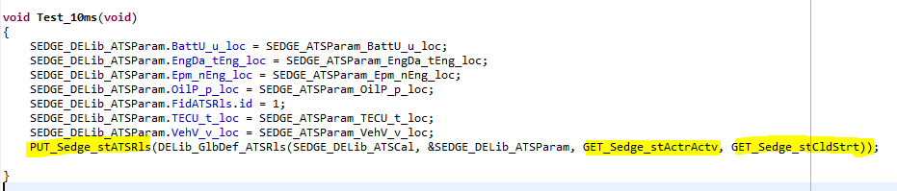
Bit type or simple model
DGS C−standard data types and Base types in MEDC17, MDG1 and AUTOSAR
15
RBVH/EJV3 | 2018-06-27
© Robert Bosch Engineering and Business Solutions Vietnam Company Limited 2018. All rights reserved, also regarding any disposal, exploitation, reproduction, editing, distribution, as well as in the event of applications for industrial property rights.

Slide 16
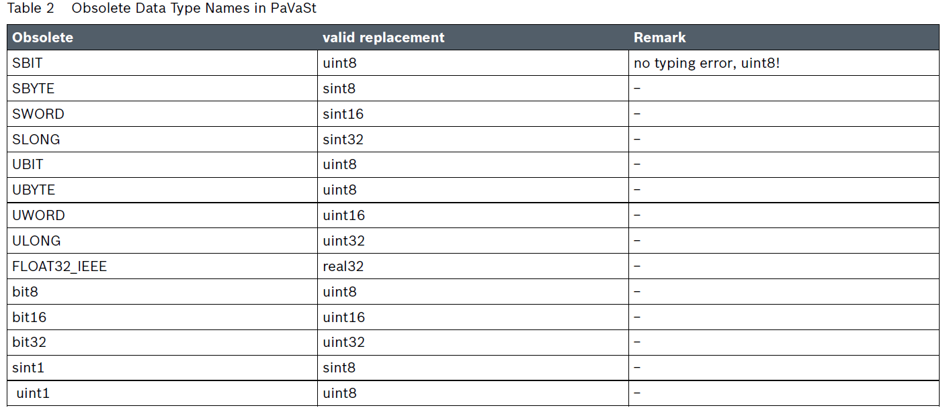
MEDC17/MDG1 Obsolete data types in PaVaSt
DGS C−standard data types and Base types in MEDC17, MDG1 and AUTOSAR
16
RBVH/EJV3 | 2018-06-27
© Robert Bosch Engineering and Business Solutions Vietnam Company Limited 2018. All rights reserved, also regarding any disposal, exploitation, reproduction, editing, distribution, as well as in the event of applications for industrial property rights.

Slide 17
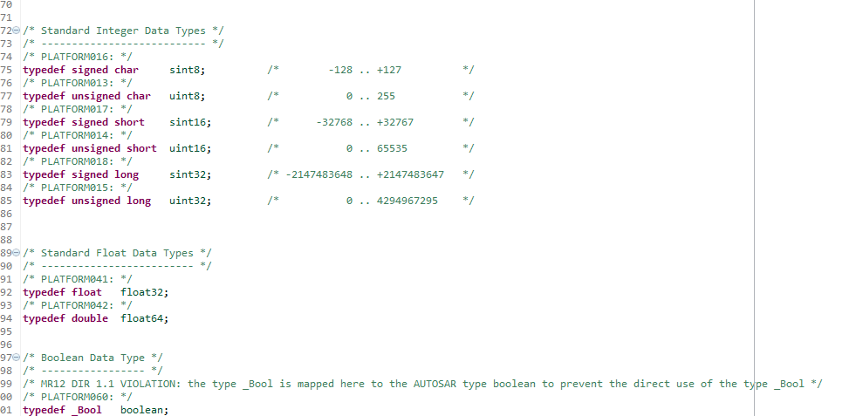
User defined data types − typedefs
DGS C−standard data types and Base types in MEDC17, MDG1 and AUTOSAR
typedefs shall not be used to define new names for the existing standard types
17
RBVH/EJV3 | 2018-06-27
© Robert Bosch Engineering and Business Solutions Vietnam Company Limited 2018. All rights reserved, also regarding any disposal, exploitation, reproduction, editing, distribution, as well as in the event of applications for industrial property rights.
Notes:
Khi muốn define một kiểu dữ liệu mới thì nên follow rule
Tạo 1 tên mới mà Khi đó standard types đã có thì ko đc sử dụng lại
Để tạo tính linh hoạt khi build trong các compiler khác nhau thì bit field ko đc sử dụng
Unions cũng thế

Slide 18
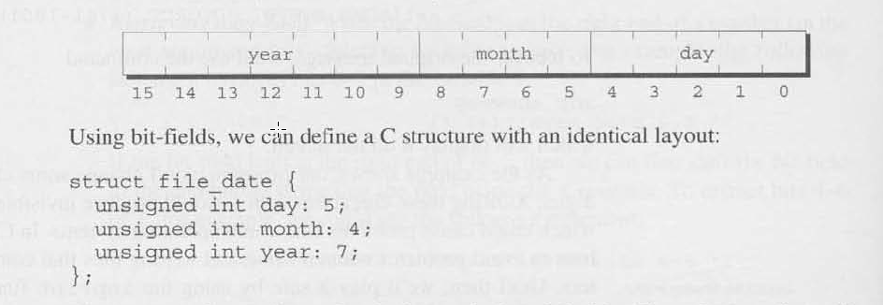
User defined data types − typedefs
DGS C−standard data types and Base types in MEDC17, MDG1 and AUTOSAR
C bit fields should not be used
18
RBVH/EJV3 | 2018-06-27
© Robert Bosch Engineering and Business Solutions Vietnam Company Limited 2018. All rights reserved, also regarding any disposal, exploitation, reproduction, editing, distribution, as well as in the event of applications for industrial property rights.
Notes:
Khi muốn define một kiểu dữ liệu mới thì nên follow rule
Tạo 1 tên mới mà Khi đó standard types đã có thì ko đc sử dụng lại
Để tạo tính linh hoạt khi build trong các compiler khác nhau thì bit field ko đc sử dụng
Unions cũng thế

Slide 19

User defined data types − typedefs
DGS C−standard data types and Base types in MEDC17, MDG1 and AUTOSAR
unions should not be used
19
RBVH/EJV3 | 2018-06-27
© Robert Bosch Engineering and Business Solutions Vietnam Company Limited 2018. All rights reserved, also regarding any disposal, exploitation, reproduction, editing, distribution, as well as in the event of applications for industrial property rights.
Notes:
Khi muốn define một kiểu dữ liệu mới thì nên follow rule
Tạo 1 tên mới mà Khi đó standard types đã có thì ko đc sử dụng lại
Để tạo tính linh hoạt khi build trong các compiler khác nhau thì bit field ko đc sử dụng
Unions cũng thế

Slide 20
Standard data type FOR special purposes

Slide 21
MEDC17/MDG1 Standard data types for special purposes
uint, sint
Represent the natural register size of CPU
Support in Pvast / tool chain
uint64, sint64
unsigned/signed 64−Bit integer types
only C definition, no support in PaVaSt/tool chain
21
RBVH/EJV31 | 2018-06-27
© Robert Bosch Engineering and Business Solutions Vietnam Company Limited 2018. All rights reserved, also regarding any disposal, exploitation, reproduction, editing, distribution, as well as in the event of applications for industrial property rights.

Slide 22
uint16u, sint16u, uint32u, sint32u, uint64u, sint64u
MEDC17/MDG1 Standard data types for special purposes
unsigned/signed 16−Bit union types to retrieve high byte / low byte
only C definition, no support in PaVaSt/tool chain
22
RBVH/EJV31 | 2018-06-27
© Robert Bosch Engineering and Business Solutions Vietnam Company Limited 2018. All rights reserved, also regarding any disposal, exploitation, reproduction, editing, distribution, as well as in the event of applications for industrial property rights.

Slide 23
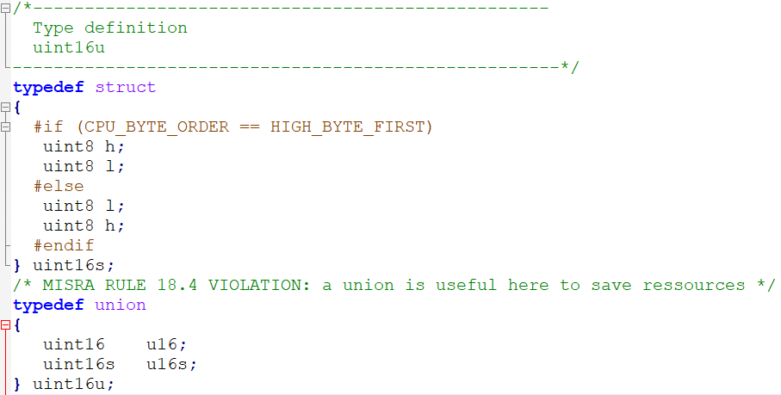
uint16u
MEDC17/MDG1 Standard data types for special purposes
23
RBVH/EJV31 | 2018-06-27
© Robert Bosch Engineering and Business Solutions Vietnam Company Limited 2018. All rights reserved, also regarding any disposal, exploitation, reproduction, editing, distribution, as well as in the event of applications for industrial property rights.

Slide 24
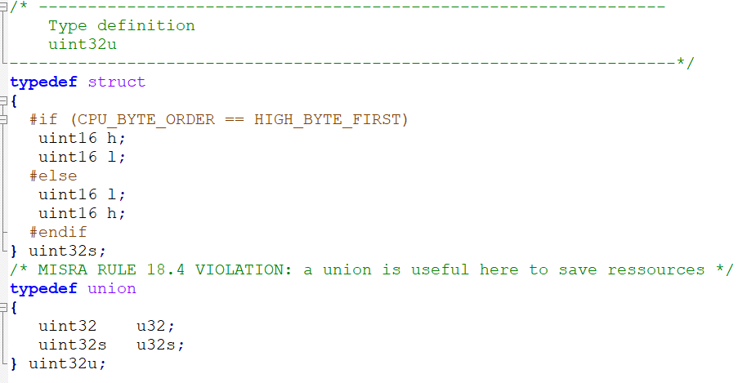
uint32u
MEDC17/MDG1 Standard data types for special purposes
24
RBVH/EJV31 | 2018-06-27
© Robert Bosch Engineering and Business Solutions Vietnam Company Limited 2018. All rights reserved, also regarding any disposal, exploitation, reproduction, editing, distribution, as well as in the event of applications for industrial property rights.

Slide 25
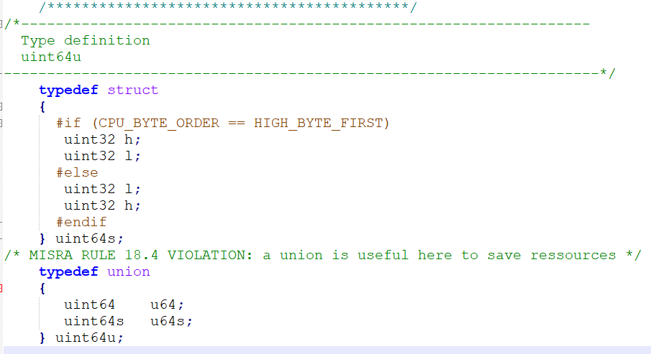
uint64u
MEDC17/MDG1 Standard data types for special purposes
25
RBVH/EJV31 | 2018-06-27
© Robert Bosch Engineering and Business Solutions Vietnam Company Limited 2018. All rights reserved, also regarding any disposal, exploitation, reproduction, editing, distribution, as well as in the event of applications for industrial property rights.

Slide 26
MEDC17/MDG1 Standard data types for special purposes
Due to risks regarding portability and maintainability or resource consumption, static verification tool could produce some warning accordingly:
E.g: Generic Integer type may cause runtime error when it is port into 16bit CPU or 32bit CPU but defined integer is 16bit.
26
RBVH/EJV31 | 2018-06-27
© Robert Bosch Engineering and Business Solutions Vietnam Company Limited 2018. All rights reserved, also regarding any disposal, exploitation, reproduction, editing, distribution, as well as in the event of applications for industrial property rights.

Slide 27
Float data types

Slide 28

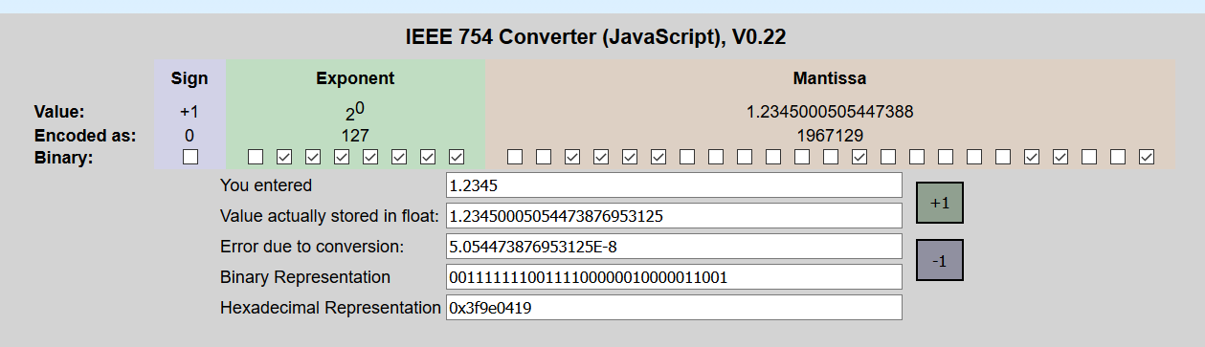
Float data types
In MEDC17 and MDG1 the following data types shall NOT be used in manually written code:
real, real64.... 64−Bit float types ("double")
28
RBVH/EJV31 | 2018-06-27
© Robert Bosch Engineering and Business Solutions Vietnam Company Limited 2018. All rights reserved, also regarding any disposal, exploitation, reproduction, editing, distribution, as well as in the event of applications for industrial property rights.

Slide 29
Size and signedness of an arithmetic type

Slide 30
Size and signedness of an arithmetic type
The smallest integer type should be used
E.g: Variable for number of etown 2 floor → range of value could be from -1 to 11 → sint8 could be used.
If possible value range is only possitive → unsigned type should be chosen (the same with negative value)
64 bit integer shall be used only in exceptional cases
For variables which hold bit masks or bit strings an unsigned type shall be used.
30
RBVH/EJV31 | 2018-06-27
© Robert Bosch Engineering and Business Solutions Vietnam Company Limited 2018. All rights reserved, also regarding any disposal, exploitation, reproduction, editing, distribution, as well as in the event of applications for industrial property rights.

Slide 31
RQONE01219816 - wrong torque calcualtion in IDAS logic
Usage of Service Library
Problem Statement:
Specification: Wrong usage of service library. 16bit service library is used in 32bit variable, this may cause less IDAS demand torque than expected.
Root Cause: IDAS Wheel-Torque-Request was limited to [-3276.7…3276.7(Nm)] because service MULDIVS16 althought IDAS request torque Input and Output have data-type of Sint32.. .
31
RBVH/EJV31 | 2018-06-27
© Robert Bosch Engineering and Business Solutions Vietnam Company Limited 2018. All rights reserved, also regarding any disposal, exploitation, reproduction, editing, distribution, as well as in the event of applications for industrial property rights.

Slide 32
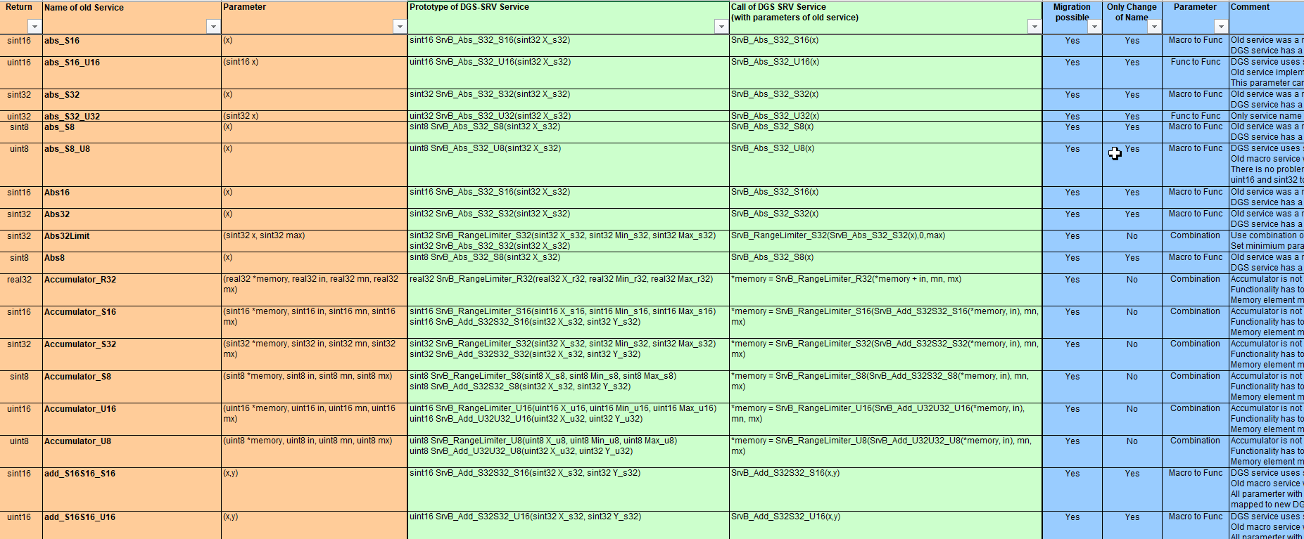
Header of section
➔ Link for Service Migration : Link
32
RBVH/EJV31 | 2018-06-27
© Robert Bosch Engineering and Business Solutions Vietnam Company Limited 2018. All rights reserved, also regarding any disposal, exploitation, reproduction, editing, distribution, as well as in the event of applications for industrial property rights.

Slide 33
References
Header of section
DGS General Coding Guideline :
http://fe-ecupkit.de.bosch.com/PDP/Procedure/aaSW_DGS-MEDC17_MDG1_General_Coding_Standard_en.pdf
Floating-point arithmetic :
https://en.wikipedia.org/wiki/Floating-point_arithmetic
IEEE-754 Floating Point Converter :
https://www.h-schmidt.net/FloatConverter/IEEE754.html
33
RBVH/EJV31 | 2018-06-27
© Robert Bosch Engineering and Business Solutions Vietnam Company Limited 2018. All rights reserved, also regarding any disposal, exploitation, reproduction, editing, distribution, as well as in the event of applications for industrial property rights.

